Slide 1
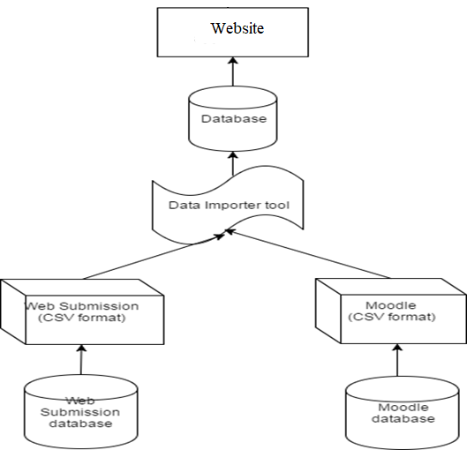
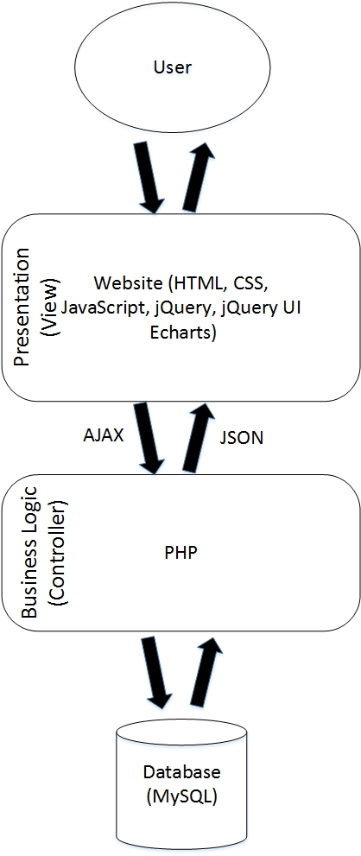
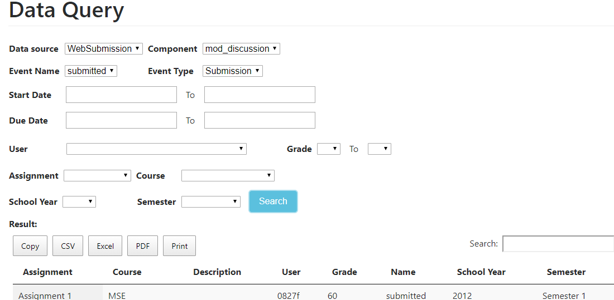
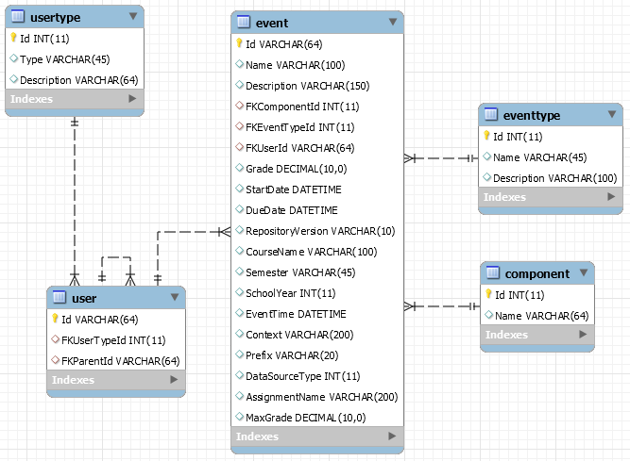
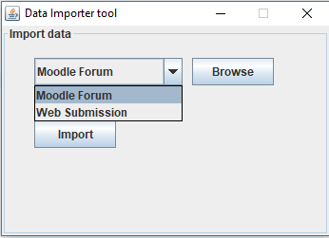
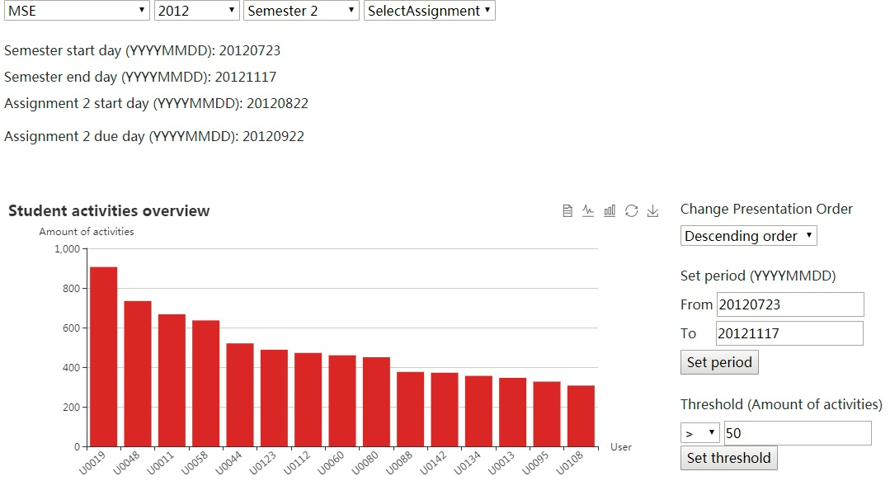
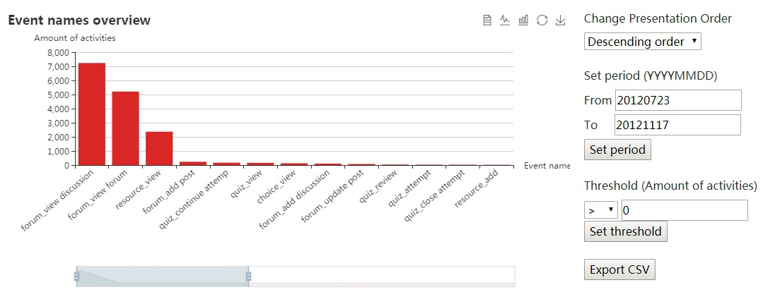
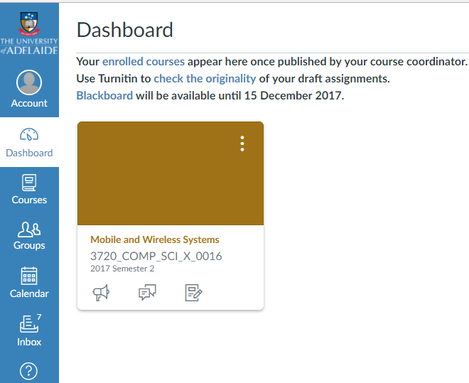
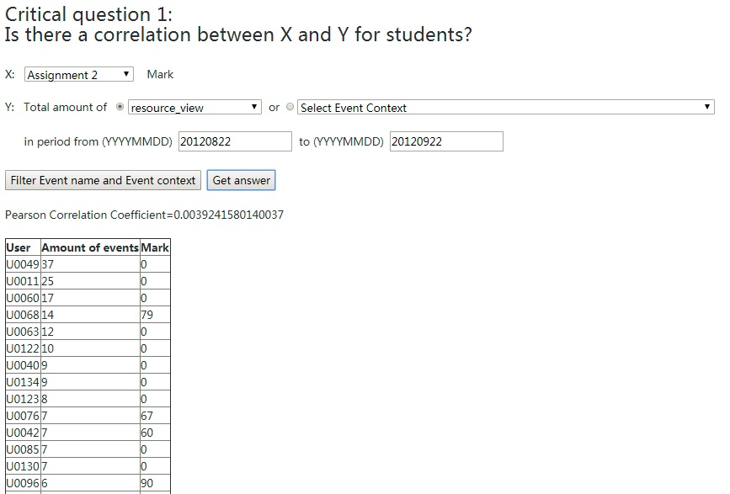
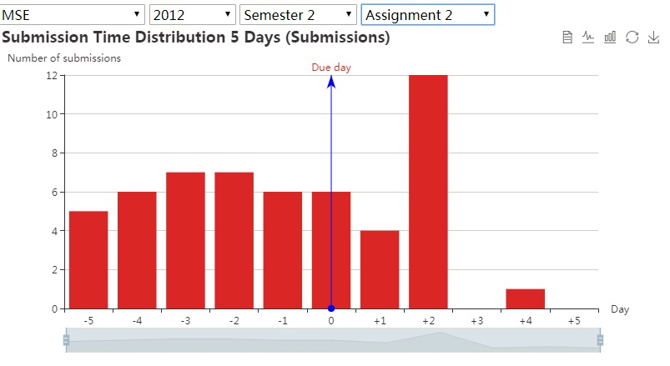
Organised Access to Historical Student Data
Zeyu Lin, Minh Tam Phan, Zeqi Fu (zeyu.lin, minhtam.phan, zeqi.fu) @student.adelaide.edu.au
Supervised by Nickolas Falkner, Christoph Treude, Claudia Szabo, Marian Mihailescu
School of Computer Science
Project Introduction
System Architecture
Data query module, importer, database.
12 years of Moodle and WebSubmission data has been collected and the problem now is organising it for searching and trend analysis.
Moodle and WebSubmission are separate systems. What we are doing is to tie the two systems together by designing a database schema that will take into consideration and incorporate both systems.
All data is anonymised and is identified in a way that allows us to associate actions without identifying the students, which ensures the privacy.
Raw data is not logically well organized and hard to read.
Visualization is provided by presenting data in the form of charts, which makes the data more intuitive.
A lot of configuration options are provided to allow users to manipulate the data displayed in the charts and allow users to interact with the charts.
Analysis module is provided to allow users to explore the relationship between the amount of students‘ activities and academic performances.
Staffs are allowed to query the database, extract data, aggregate it, and export it.
Extraction and insertion scripts (data importer) that work with the file-based storage for the current data are provided.
The database schema is built based on two data sources (Moodle Forum and WebSubmission).
Data Importer tool extracts data from data sources to database.
The website displays and analyzes data by charts and tables.
The website is designed in a decoupled way. It adopts two-tier model, which separates the front-end and the back-end.
Data Query module can support staff to query and extract data.
A combined database of Moodle Forum and WebSubmission data sources.
Can be flexibly applied for newly added data sources such as Canvas.
Data importing tool can assist to import data from data sources into database.
Charts and analysis module
Advantages
Provide visualization by using charts, which make the data intuitive and easy to read.
Provide lots of configuration options and related functions (set period, change presentation order, threshold function, export data in CSV format, event name/ event context auto-complete), which allow user to further explore and manipulate data.
Allow user to choose course, year, semester, assignment.
Provide data of individual student as well as the whole class.
Provide the amount of different events in a given period as well as the amount of specific event of each day.
Link two data sources and link the users of two data sources.
Provide cross data analysis: allow user to explore the relationship between the amount of students' activities and academic performances.
The database is flexible and can be applied for multiple data sources.
Having tools to import data from external files.
Visualization makes the data intuitive.
Charts are configurable, which allows user to manipulate and further explore data.
Provide analysis across two data sources. Link two data sources and link the users of two data sources without identifying their names.
The website can be used to query, analyze and extract data with the support of charts and tables.
Project Objective
Future Work
Design a database schema that incorporate the two separate systems (Moodle and WebSubmission).
Link two data sources and link the users (which are anonymized) of two data sources.
Write extraction and insertion scripts (data importer) to import current file-based data.
Provide visualization of data by using charts and make them configurable to allow users to manipulate and interact with data.
Analyze the relationship between the amount of students‘ activities and academic performances.
Allow staffs to query the database, extract data, aggregate it, and export it.
Modify the schema to work with new data source (Canvas).
Add new data sources (e.g. student GPA) for further cross data analysis.
Provide charts (across semesters) of the same course for trend analysis and comparison.
Acknowledgement
This project was supported by the School of Computer Science. We gratefully acknowledge the feedback and contribution of Nickolas Falkner, Claudio Szabo, Christoph Treude and Marian Mihailescu.

